Slide 1

Single Parent Effects on Children Outcome
Redi Sunarta - 1606888216
*sangat sementara

Slide 2
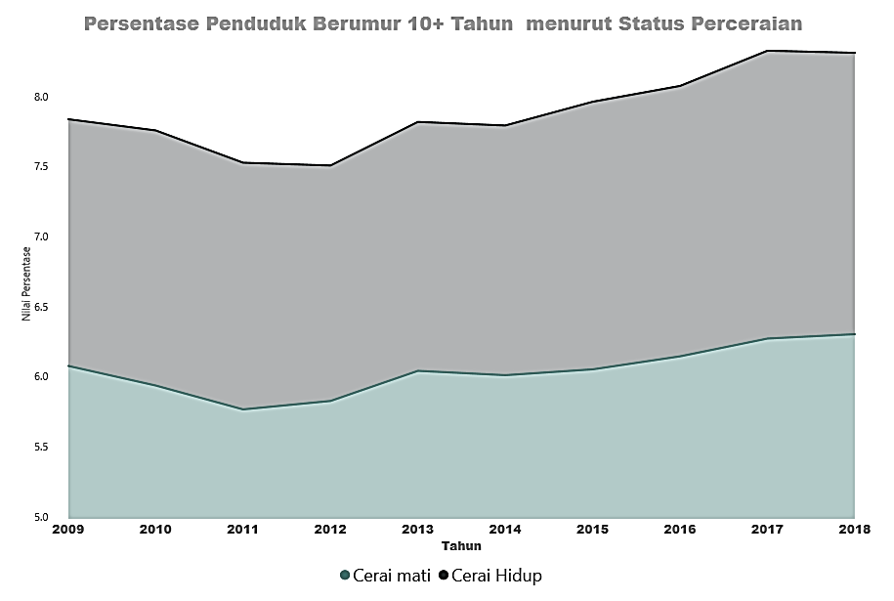
Introduction
The role of parents is vital.
Tren number of single-parent is increasing.
Lack of related literature.
There has been no serious govt attention.
Highly cost.

Slide 3
Objective
Analyze differences in parenting outcomes from single-mother and single-father, either short-run nor long-run effect, on health condition and education output of children.
Analyze differences in parenting outcomes from single-parent and married couple, either short-run nor long-run effect, on health condition and education output of children.

Slide 4
Novelty
Literature that discusses differences in parenting outcomes from single-mother and single-father in the long run is relatively rare, especially in the Indonesian context.
Consideration in determining child custody.
Reinforce previous findings that divorced or being widows have a significant negative effect on children, using the Indonesian context

Slide 5
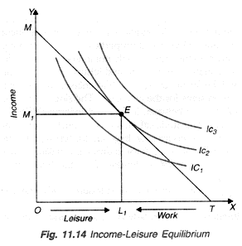
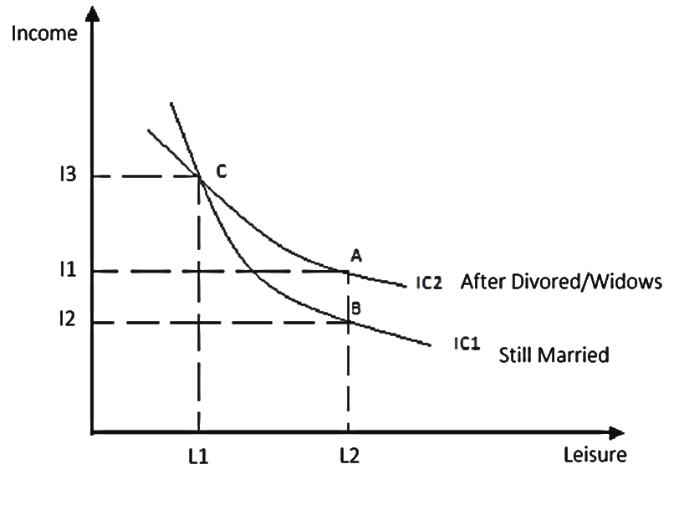
Framework
Being Single Parent change
their function of utility curve, People tend to reduce willingness to pay one additional leisure relatively to income.

Slide 6
Literatur Review
Myriam de Loenzien (2016) analyses show that children of lone mothers are at a higher risk of dropping out of school than those living with two parents. (Vietnam)
Wan-Chi Chen (2016) examines an important source of potential help to one-parent families– grandparents. Lone fathers in Taiwan are more likely to co-reside with their own parents. (Taiwan)
Cheung and Park examine (2016) said adolescents in lone-father families perform significantly worse academically than those from both two-parent and lone-mother families. (Hong Kong)
Dhiman Das (2016) finds that separated or divorced mothers spend less on their children’s education. (India)

Slide 7
Method
Data
IFLS Wave 2 – 5
Objective (1)
Correlation
OLS
not yet known
Already not married
AND have school-age children
(main objective)
Objective (2)
Matching
DiD

Slide 8
Reference
Adam Ka-Lok Cheung & Hyunjoon Park (2016) Single Parenthood, Parental Involvement and Students’ Educational Outcomes in Hong Kong, Marriage & Family Review, 52:1-2, 15-40, DOI: 10.1080/01494929.2015.1073650
Dhiman Das (2016) Enrollment, Educational Expenditures and Work Among One-Parent Children in India, Marriage & Family Review, 52:1-2, 196-215, DOI: 10.1080/01494929.2015.1073652
Myriam de Loenzien (2016) Lone Motherhood and its Educational Outcomes for Children in Vietnam, Marriage & Family Review, 52:1-2, 162-195, DOI: 10.1080/01494929.2015.1136859
Raymo JM (2016). Single Motherhood and Children's Health and School Performance in Japan. Marriage Fam Rev. 52(1-2):64–88. doi:10.1080/01494929.2015.1076554
Wan-Chi Chen (2016) The Role of Grandparents in Single-Parent Families in Taiwan, Marriage & Family Review, 52:1-2, 41-63, DOI: 10.1080/01494929.2015.1073654

